Slide 1



HELIX SNAKE
CME1252 Project Based Learning - II
Rıdvan Özdemir Hazar Özyağcı İlker Baş
2017510086 2017510090 2017510016

Slide 2












OUTLINE
01
Introduction
Progress Summary
02
03
Problems Encountered
Algorithms and Solution Strategies
04
05
Screenshots
Conclusion
06
07
References

Slide 3

INTRODUCTION
The aim of the project is to develop a snake game
The game is played in 25*60 area
There are twenty amino acids which are represented with codons
Each codon contains three letters
A (Adenine) C (Cytosine)
G (Guanine) T (Thymine)

Slide 4




PROGRESS SUMMARY
Changes In Requirements
Additional Improvements
Task Sharing and Scheduling
Completed Tasks

Slide 5
PROGRESS SUMMARY
CHANGES IN REQUIREMENTS
Reversing the snake for codon scoring by using string.
By using another Single Linked List instead.

Slide 6




PROGRESS SUMMARY
TASK SHARING AND SCHEDULING
Designing necessary classes and data structures.
Simple Snake
Simple Screen
Additional Improvements
Visualization
Snake moving, eating and growing/expanding in size.
Scoring implementation for single letter eating.
Error Controls
Preparing for the presentation of the project.
All time high-scores(TXT-DLL).
Scoring implementation with codon points(MLL).

Slide 7




PROGRESS SUMMARY
COMPLETED TASK
Eating, moving and growing
High-Scores
Scoring
Single Letter Eating
Codon Points
File Operations
User Interface
Replay

Slide 8






PROGRESS SUMMARY
ADDITIONAL IMPROVEMENTS
Coloring the snake and the maps
Menu, score table and tutorial
Two maps, Normal and Advanced
Speed options; Slow, Normal and Fast
Portal feature for Advanced map
New game rules for Advanced map

Slide 9




PROBLEMS ENCOUNTERED
Using direction keys for movement
Placing of letters
Duplication of the score table
Repetition errors

Slide 10

ALGORITHMS AND SOLUTIONS
Initialization of Map and Snake
Map information is being held in a two-dimensional array
Snake is created by using SLL and placed in a random location of the map

Slide 11



ALGORITHMS AND SOLUTIONS
Snake Moving
According to Pressed Direction
PRESS ?
According to Last Direction
Coordinates of head changes, the others follow the head.

Slide 12
ALGORITHMS AND SOLUTIONS
Eating and Growing/Expanding
Based on head
Control the next element
Finish game whether next element is wall
Do not change other elements

Slide 13




ALGORITHMS AND SOLUTIONS
Scoring
Give +5 point to player for each letter which is ate
Read codons with their points from txt file to multi linked list
Control snake with counter
Take last three letters
Compare with multi linked list

Slide 14



ALGORITHMS AND SOLUTIONS
Highscore
Read from txt and write to txt again
Sort scores with double linked list
Show top 10 scores
Refresh the score which have same player name
Disregard the smaller score

Slide 15

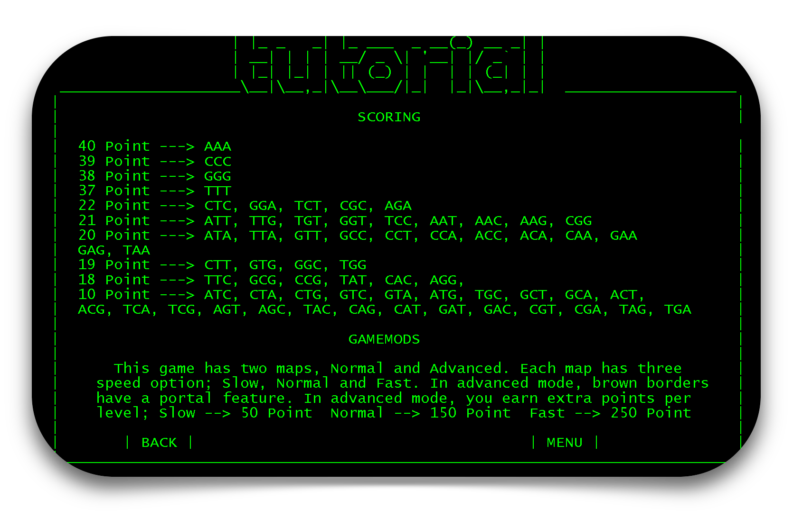
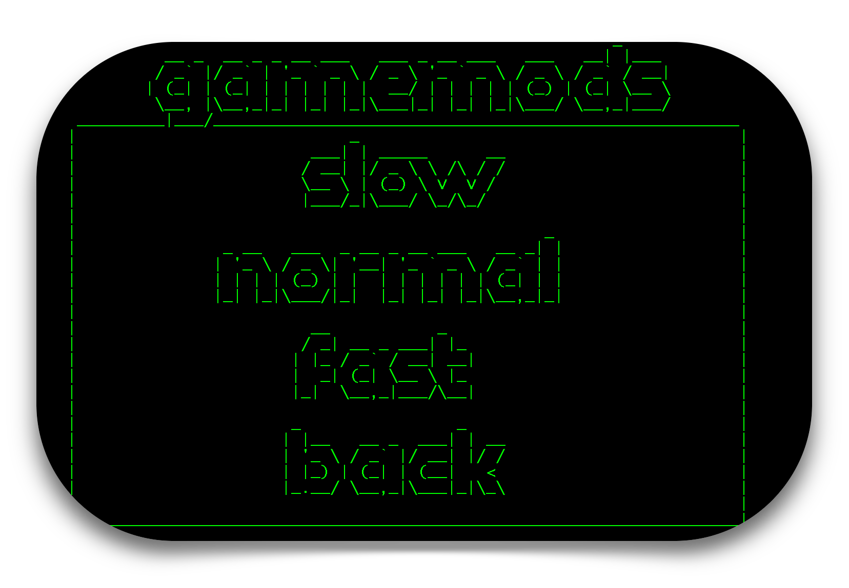
SCREENSHOTS

Slide 16
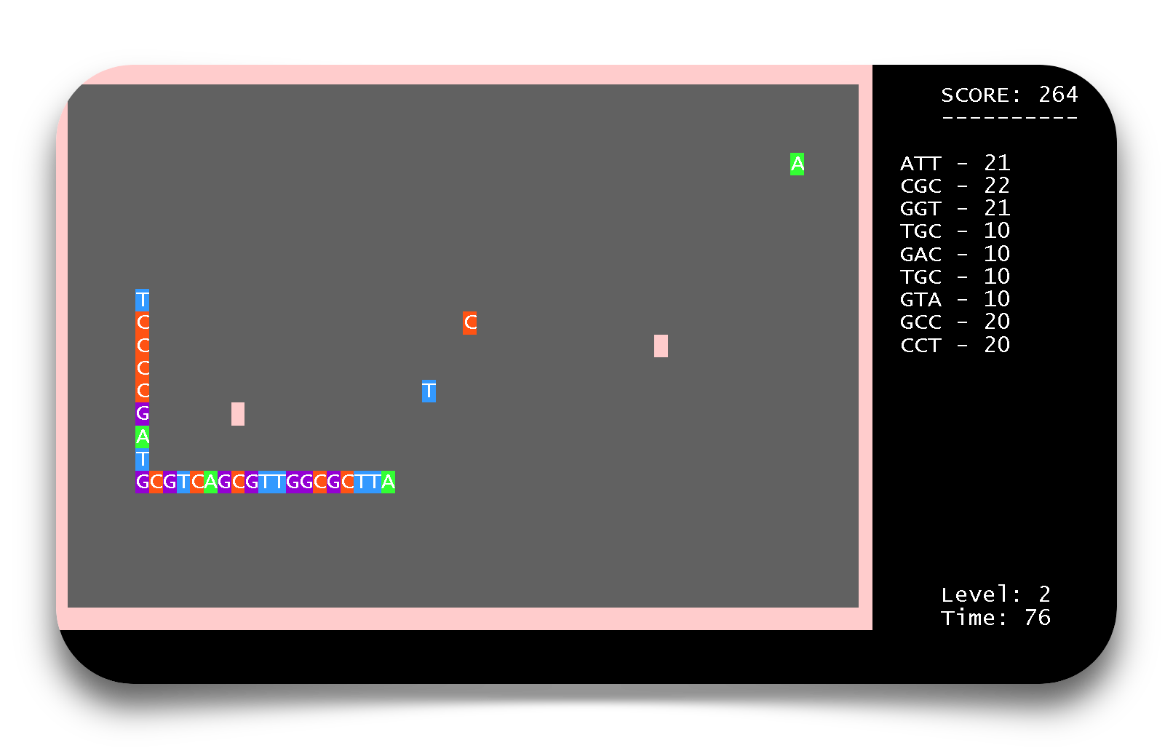
SCREENSHOTS

Slide 17
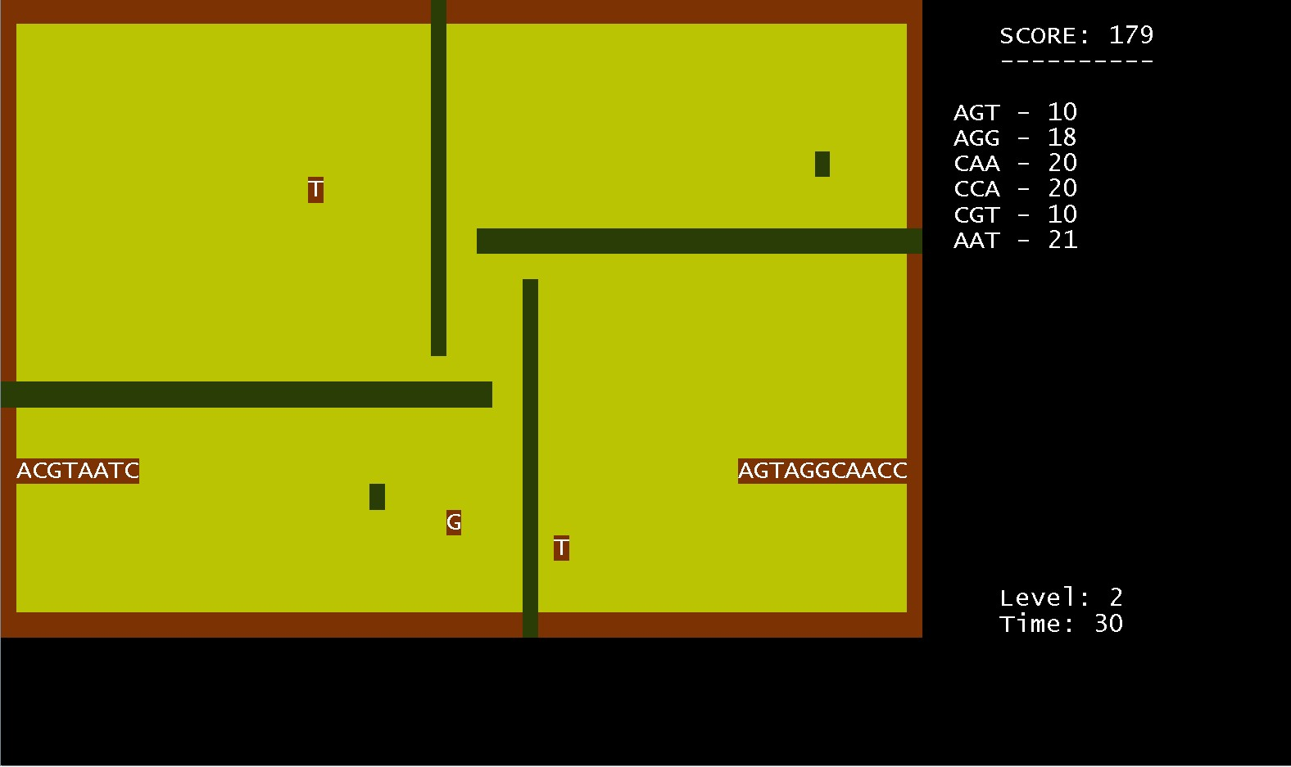
SCREENSHOTS

Slide 18
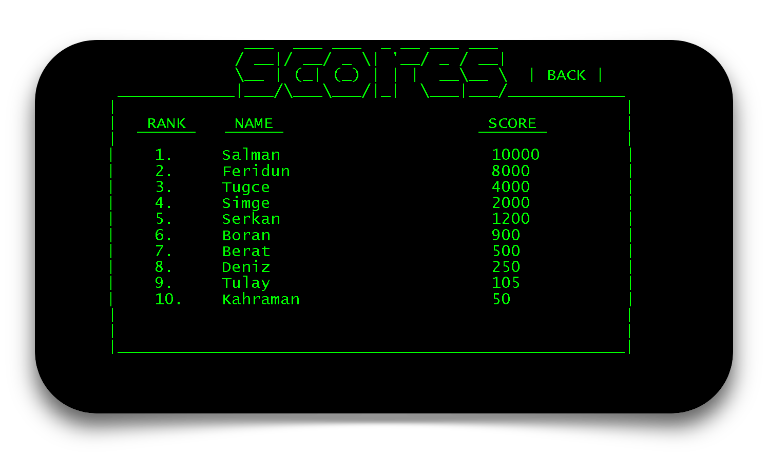
SCREENSHOTS

Slide 19

CONCLUSION
The goals are achieved
Stayed in standards
Finishing in time
No missed task
Additional Improvements
Object oriented programming
Entirely teamwork
Reported progressions

Slide 20
REFERENCES
Doç. Dr. Fahri VATANSEVER , Algoritma Geliştirme ve Programlamaya Giriş (2017), ISBN 978-975-02-4430-8
II. Dosyalama Komutları (sayfa 396)
https://www.geeksforgeeks.org/data-structures/linked-list/
Linked List Data Structures (25.04.2019)
https://docs.oracle.com/javase/7/docs/api/java/util/Timer.html
Class Timer (23.05.2019)
https://www.kodlamamerkezi.com/java/java-timer-zamanlayici-kullanimi/
Java Timer (23.05.2019)

Slide 21
QUESTIONS ?

Slide 22
THANK YOU.
Hazar Özyağcı
Rıdvan Özdemir
İlker Baş

